Slide 1

EFFECT OF MOBILITY ON COVID-19
VARUN GUPTA
DEPARTMENT OF CHEMICAL ENGINEERING

Slide 2
ABSTRACT
Covid-19 virus is spread via direct contact with the carrier or the infected individual.
With the advancements in modern transportation, human interactions have increased drastically and play an important role in social contact structure.
Compartmental Models available for epidemiology have been widely used to model pandemic situations and suggest public policies.
These models do not capture factors such as human interaction, age, gender etc. very well.
Mobility is the method to associate human interactions with quantifiable numbers representing the total contacts made by the given population.
Our aim is to construct mobility time series for both country and city levels and to suggest possible improvements in the model used.

Slide 3
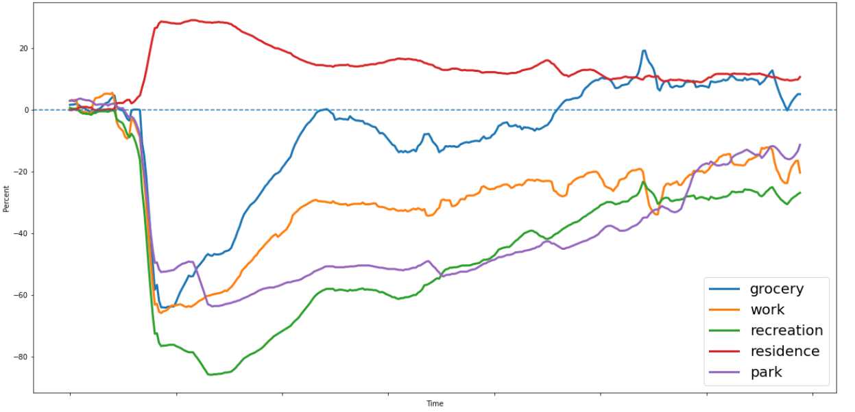
MOBILITY DATASET
Google are pioneer in developing open-source mobility data-set for both country and city levels.
The data is divided into certain categories – grocery, work, recreation, residence and park.
The data is represented in form of percentage change to a baseline value which is different for each category and is not released publicly.
The baseline is calculated with the data available before onset of Covid-19 not available publicly
We will only consider inter-city mobility in our model.
We are interested in determining the baseline which can be argued as the total contacts in a city/country.

Slide 4
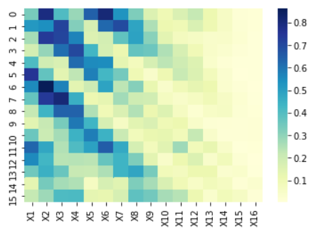
CONTACT MATRICES
It is intuitive to argue that total contacts must be a function of population and population density for a particular place.
We consider a data-set from a research study which provides contact matrices for 152 different countries.
Alongside we can see the contact matrix for India. X1 to X16 are the age bins of size 5. Each cell denotes number of contacts made by a particular age-group with another.
Contact Matrices are provided in 4 categories – School, work, home and others

Slide 5
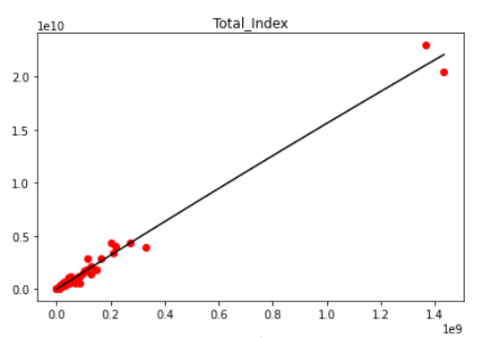
BASELINE MODEL
Using Contact Matrices and Population data-set we developed the total contacts made in a country each day.
The figure shows the total contacts vs population for 152 countries.
We used various modelling techniques such as linear regression, random forest, XG Boost alongside various combination of dependent variables such as population, population density and population squared.
We achieved best results using population and population squared as dependent variable.

Slide 6
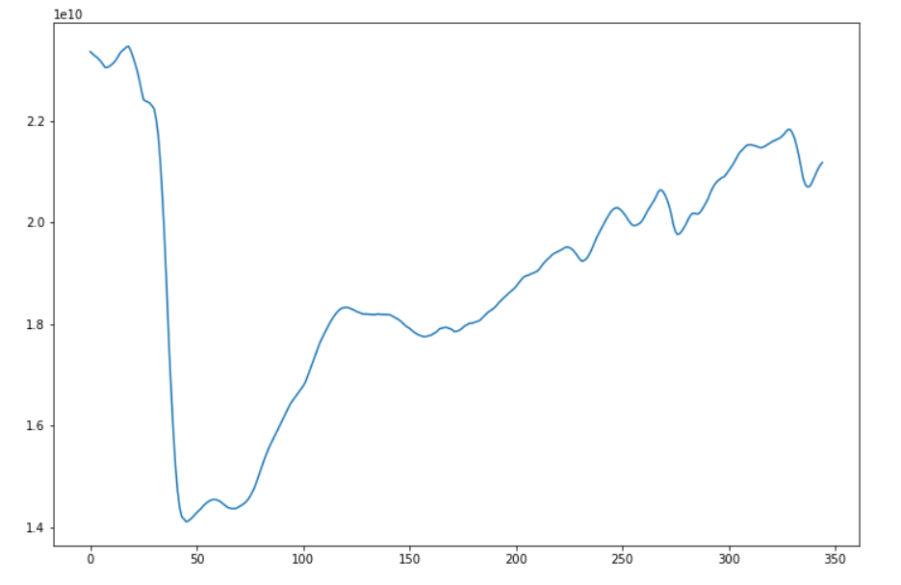
MOBILITY TIME SERIES
Using the baseline model, we can now instantaneously predict total contact for city/country.
Combining values from both google data-set and baseline values over all the different headers we calculated mobility time series for most of the cities and on the country level.
The time series starts around 20th February 2020. We can clearly see the effect of lockdown and its gradual upliftment.

Slide 7
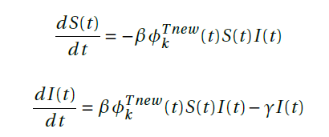
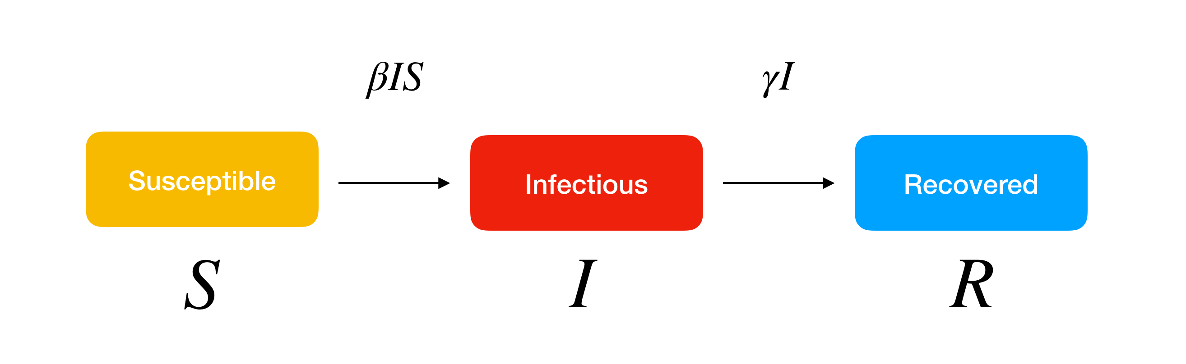
CONCLUSION
Population density remains an important factor to consider in baseline modelling. In our model use of country wide data mitigated the role of this factor because population is not homogenously distributed.
The new system of equation proposed is mentioned alongside. The parameter Φ is the mobility time series introduced in the rate law itself.
The mobility time series used with a delay of around 14 days which is the average time for an individual to display symptoms if any.

